Slide 1
Capstone project
Optimizing Superstore Marketing Campaign: Identifying Key Factors and Predicting Results Using Machine Learning
Nechama Wilhelm
7/28/2024

Slide 2
Outline
Introduction
Data
EDA
Models
Results

Slide 3
Business Problem The Superstore Is Launching A Year-end Sale With A New Gold Membership Offer, Providing A 20% Discount For $499 (Down From $999), Exclusive To Existing Customers. The Marketing Campaign Will Be Conducted Through Phone Calls.
Objective
Develop a predictive model to forecast the likelihood of customers purchasing the membership and identify key influencing factors.
Business Value
By accurately predicting likely purchasers, the superstore can target marketing efforts more effectively, reducing costs, increasing conversion rates, enhancing customer satisfaction, and boosting sales.

Slide 4
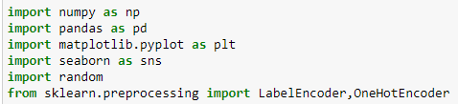


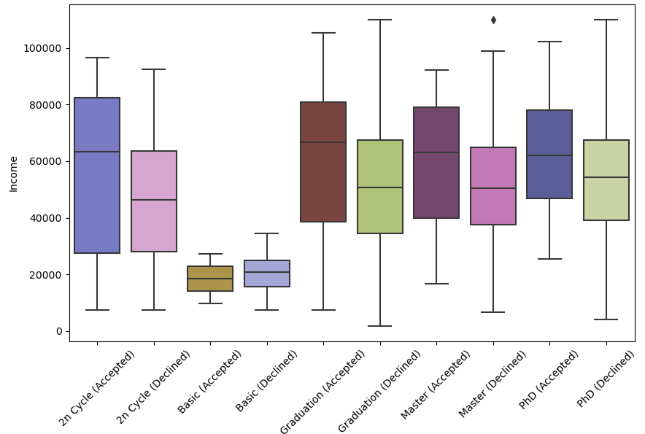
Problem nt
Data
The data, sourced from kaggle has 2240 entries, 21 features and 1 binary target.
Features include customer demographics such as age and income, amounts spent on various product types like meat, and number of purchase through different channels.
The target (Response) indicates whether the customer responded positively or negatively to last year’s campaign.
Income was the only feature with null values. These were replaced with their mean based on response and education.
Income split by education and response

Slide 5


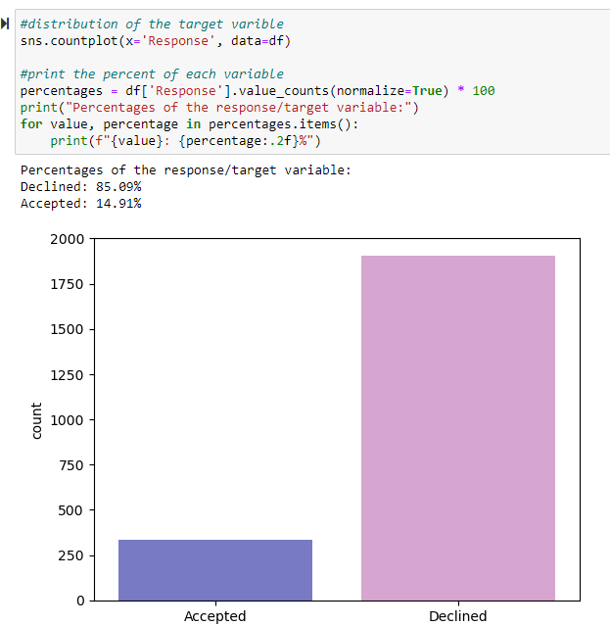
Problem statement
Data Cont.
The target variable is not balanced—only 15% of customers accepted last year’s campaign.
Year of birth and Date customer enrolled were changed to age and tenure at the time of the campaign.
A few marital statuses were similar, so they were consolidated into one.

Slide 6
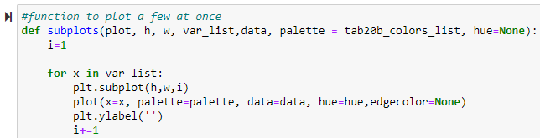
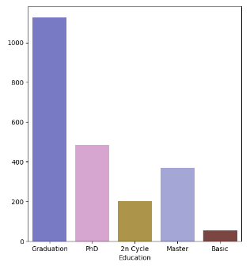
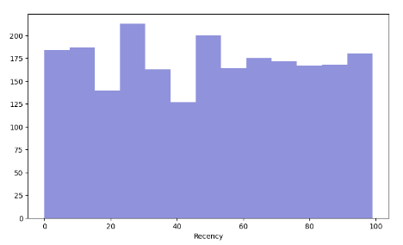
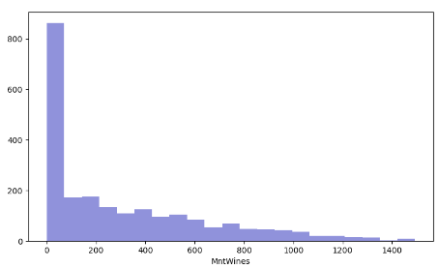
Exploratory data analysis
I used the `subplots` function to create bar plots and histograms for all the features, both individually and segregated by response.

Slide 7
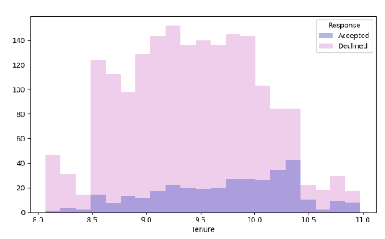
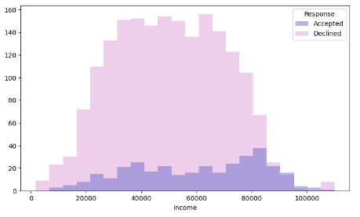
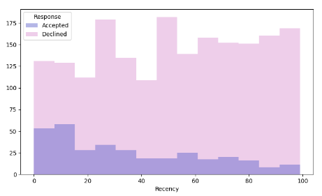
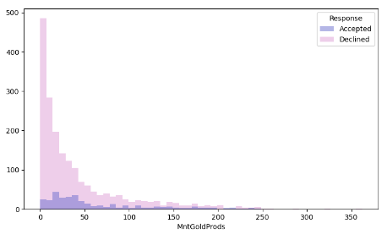
Exploratory data analysis
A few patterns emerge when the features are separated by response.
The distributions of Income and Tenure among those who accepted the campaign changed from normal to left-skewed, suggesting higher income and longer tenure with the store.
Recency exhibits a right-skewed distribution, indicating that more recent purchases are more likely to yield a positive campaign response.
Regarding gold purchases, individuals who made at least one purchase are more likely to respond affirmatively.

Slide 8
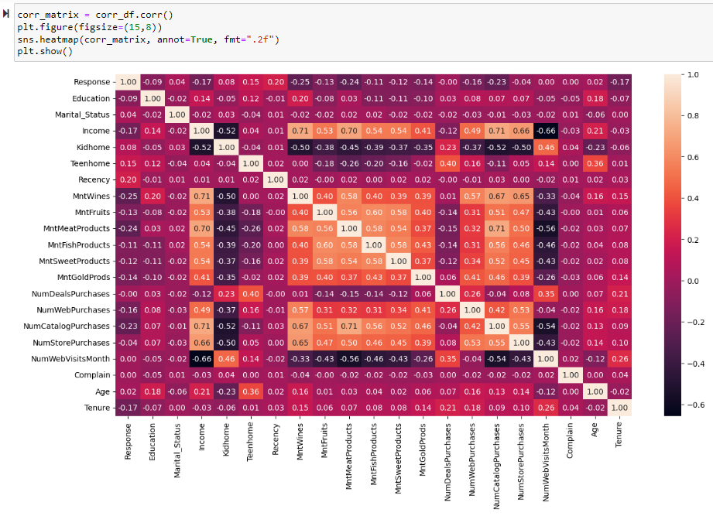
Data Correlation
No feature is strongly correlated to the target, Response.
Income has strong positive and negative correlations to many features.
The different product types purchased are all positively correlated.

Slide 9
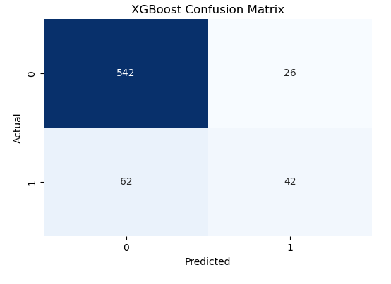
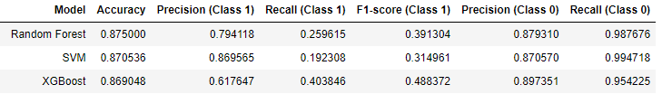
Models
I trained three predictive models: Random Forest, XGBoost, and SVM.
The first models did not perform well because the data was imbalanced.

Slide 10
Models
Rebalanced the data using Smote.
The minority class was resampled to be 75% as big as the majority class

Slide 11
Feature selection and optimization
Due to the large number of features, I decided to remove some features for the SVM models. Income was strongly correlated to many other features, but too important to remove. Instead, I removed a few other features that had strong correlations to income and to each other.
Initially, fitting the random forest and XGBoost models with the reduced training set led to subpar performance. Consequently, I refit these models using the original dataset
For each model, I utilized GridSearchCV or RandomizedSearchCV to identify the optimal hyperparameters.

Slide 12
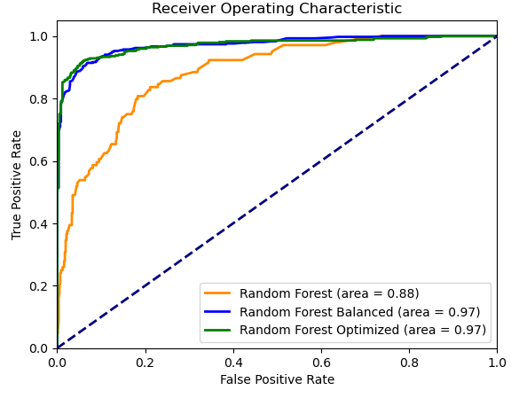
Random Forest Classifier Results
 | Regular | Balanced | Optimized
Accuracy | .88 | .92 | .93
Precision (accepted) | .79 | .93 | .94
Recall (accepted) | .26 | .89 | .90
F1-Score (accepted) | .39 | .91 | .92
Precision (declined) | .88 | .92 | .93
Recall (declined) | .99 | .95 | .96

Slide 13
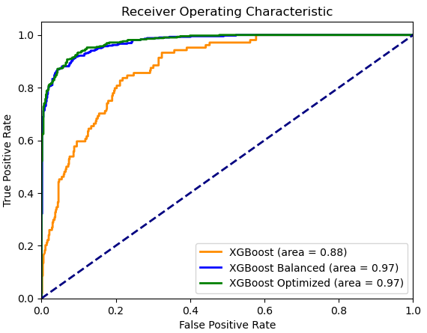
XGBoost Classifier Results
 | Regular | Balanced | Optimized
Accuracy | .87 | .91 | .92
Precision (accepted) | .62 | .89 | .91
Recall (accepted) | .40 | .89 | .89
F1-Score (accepted) | .49 | .89 | .90
Precision (declined) | 90 | .92 | .92
Recall (declined) | .95 | .92 | .93

Slide 14
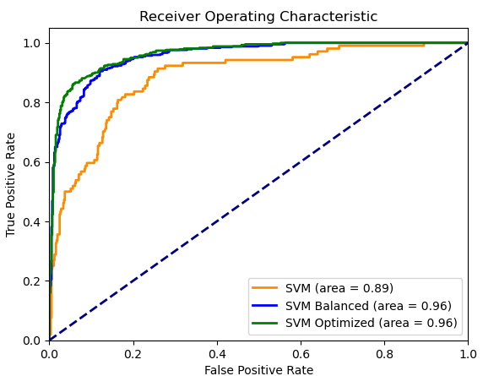
SVM Classifier Results
 | Regular | Balanced | Optimized
Accuracy | .87 | .89 | .90
Precision (accepted) | .87 | .86 | .87
Recall (accepted) | .19 | .86 | .89
F1-Score (accepted) | .31 | .86 | .88
Precision (declined) | .87 | .90 | .92
Recall (declined) | .99 | .90 | .90

Slide 15
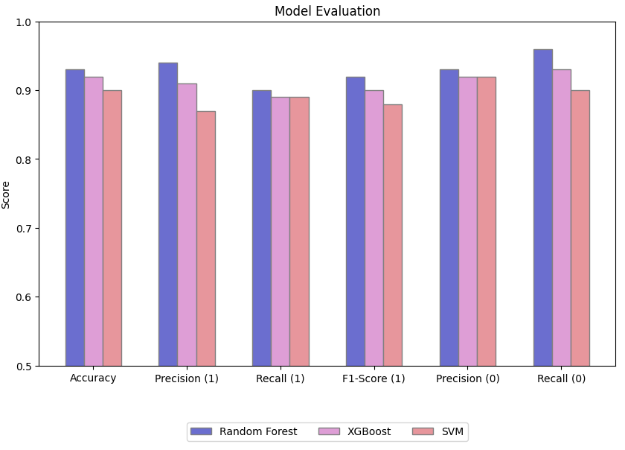
Results
Random forest outperformed the models in every measure.
It did well specifically in precision. This can minimize costs of the campaign

Slide 16
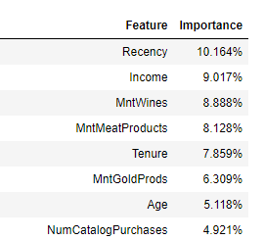
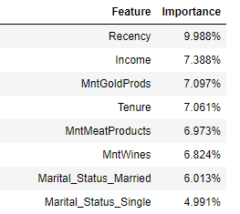
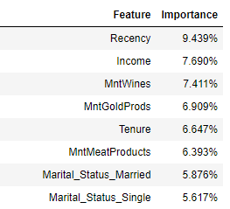
Key Features
Top Feature importance 3 random forest models. One trained on original data, one on balance data and one is the optimized model.

Slide 17
Questions?

